Slide 1
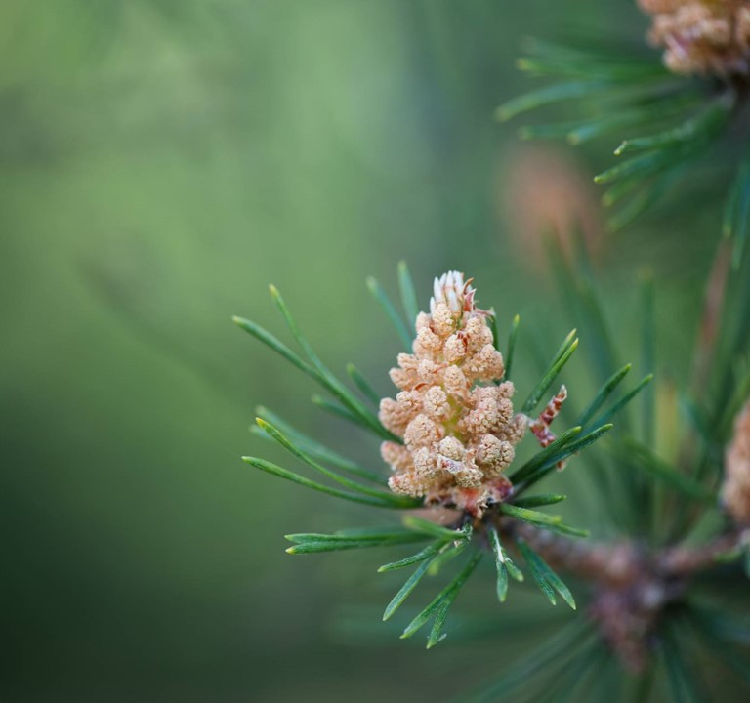
PLANT LEAF IDENTIFICATION INTER-IIT TEAM-SELECTION TASK
Deepali Sukhija (3rd year)

Slide 2

Table OF contents
Problem Statement
Dataset Creation
Building Model
Screenshots of Results and Web Application

Slide 3


Problem statement
You are given a plant leaf dataset and through digital image processing techniques you are required to do Identification of plants through plant leaves on the basis of their shape, texture and color features.
Further you are required to create a dataset using the extracted features to train and test the model.

Slide 4
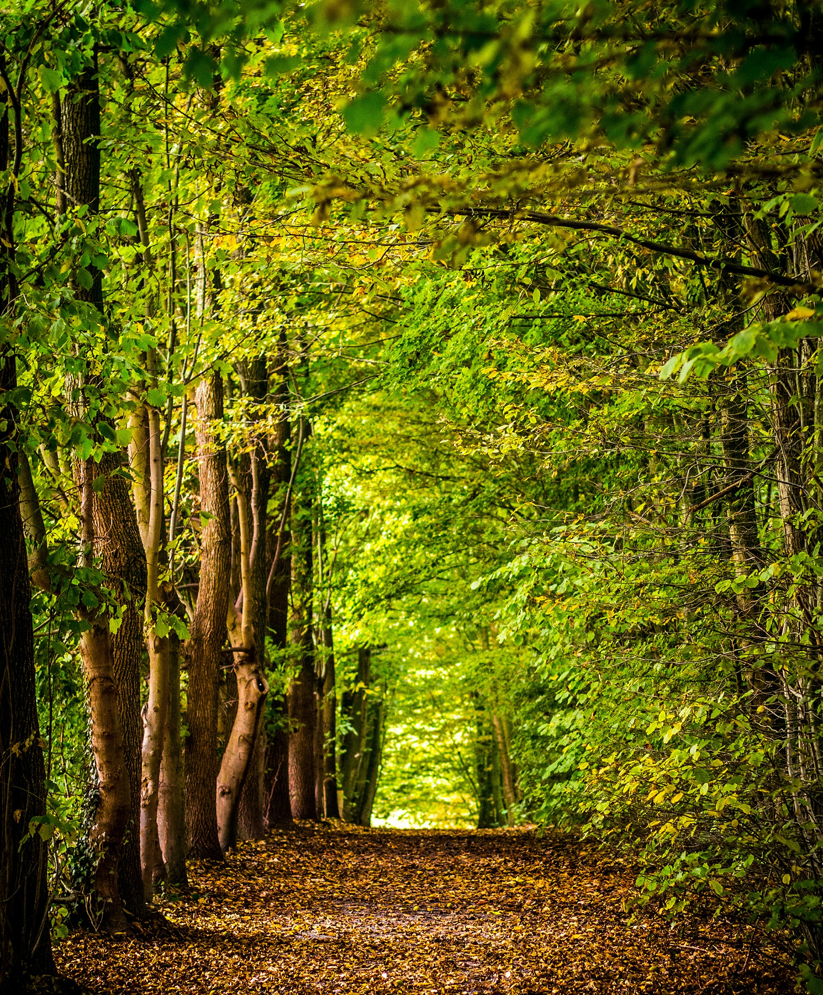
Dataset creation
Feature creation using image processing

Slide 5
Feature creation using image processing
Thresholding
Thresholding using Otsu's thresholding method.
Morphological Operations
Morphological operations are simple transformations applied to binary or grayscale images.
Shape, Color and Texture based features
Calculated - Aspect ratio, rectangularity, circularity.
Target Label
To create target labels, category points were made to distinguish between species and are accordingly assigned to respective images.
Otsu’s thresholding
Thresholding allows us to separate the foreground from the background of the image.
automatically compute the optimal threshold value based on the input image.
They are also used to close holes between objects.
Calculated- mean, std-dev of the RGB channels.
Calculating texture based features such as contrast, correlation, entropy.

Slide 6
Model building

Slide 7
Model building
Step1
Step 2
Step 3
Data found from feature extraction is used to generate a csv file.
X: Feature variables, y: target labels.
Train-test split to split the data into training and testing sets.
Performed Feature scaling using StandardScaler.
Choosing the best model from various classifying models like-
RandomForest Classifier
Support Vector Machine
KNN Classifier
Naïve Bayes
After finding the best model(SVM here), perform hyperparameter tuning on that model using GridSearchCv and trained the model and calculated the accuracy of the model.

Slide 8
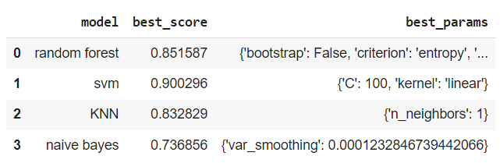
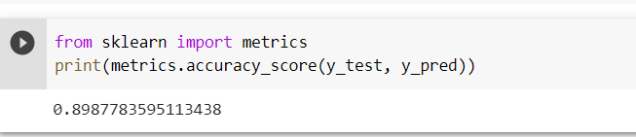
Results

Slide 9
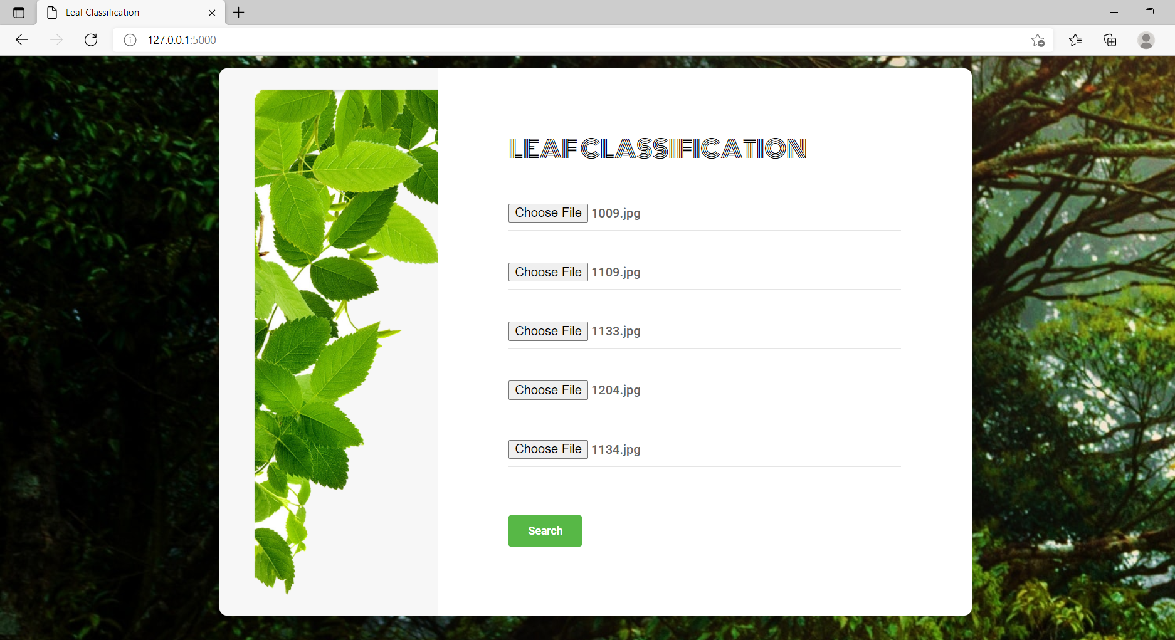
Screenshots of the deployed model

Slide 10
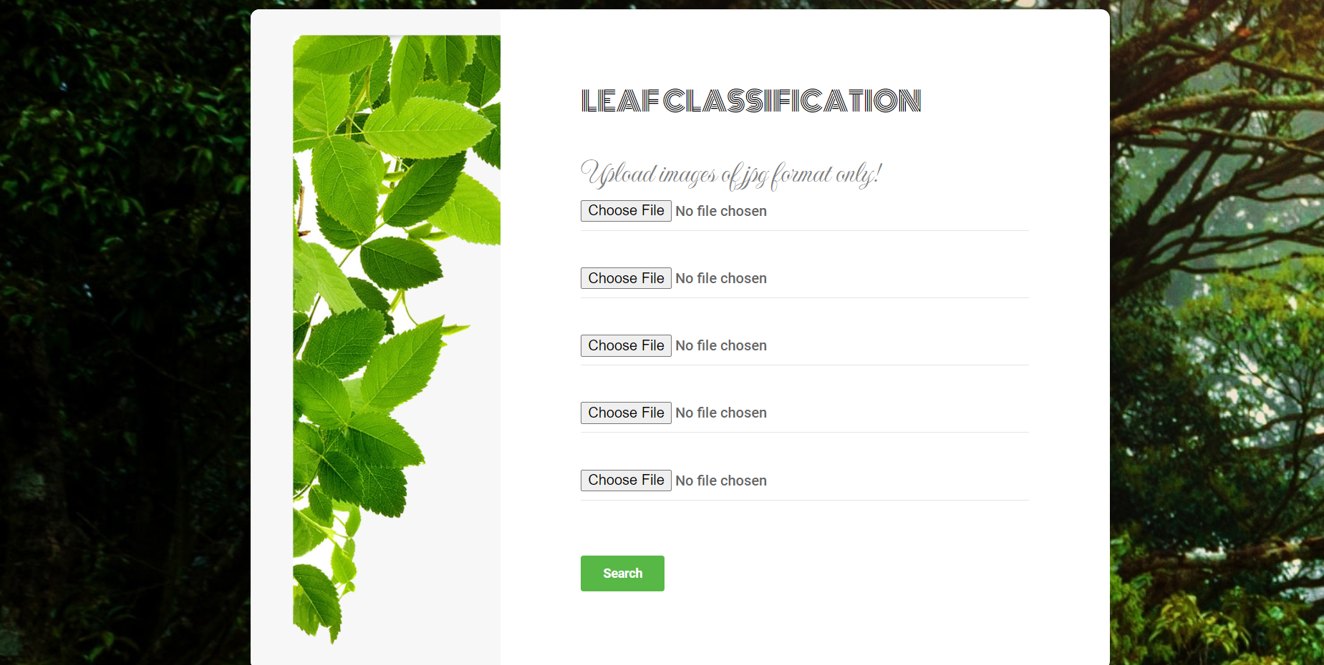
When format of image was wrong

Slide 11
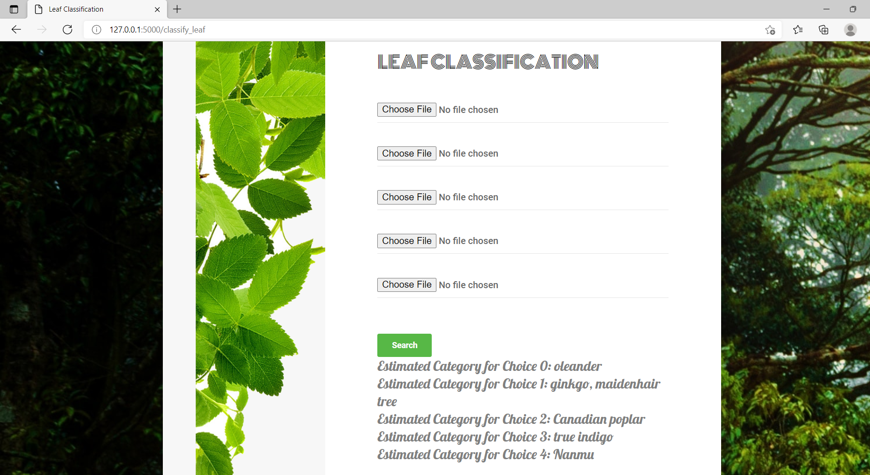
Displaying of Results

Slide 12
Thank you

